Slide 1
Additional Assignment Resources
Overloading & Friends

Slide 2
Outline
Polymorphism and overloading.
Overloading …
  Operators, functions, and constructors.
What is a friend?
  Declaring a friend function.
Accessing data from two classes.
Rules for operator overloading.
More specific overloads:
  Overloading an arithmetic operator.
  Overloading operators to work with a class object and a primitive type.
  Overloading << for output.
  Overloading >> for input.
  Overloading the ++ and -- operators.
  Overloading the == operator.
  Overloading the = operator.
  Overloading the subscript and parentheses operators.
  Overloading new[].

Slide 3
Polymorphism
Polymorphism is the object-oriented program feature that allows the “same operation” to be carried out differently depending on the object.
For example,
  clerk.displayValues();
  shirt.displayValues();
  XYZCompany.displayValues();
Polymorphism plays a more significant role when we get to inheritance; we can use the same function name without needing to know in detail which object the function is being applied to.

Slide 4
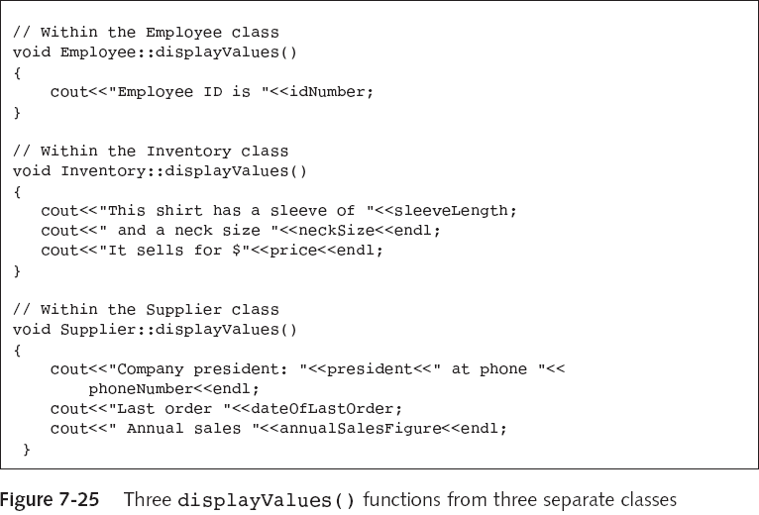

Slide 5
Overloading
Overloading is one “polymorphism” mechanism.
When you overload a function, the function name is polymorphic.
As with the previous example, we use the same name but it is interpreted differently in the different context.
Overloading is not considered “pure polymorphism”.
Purists distinguish overloading and polymorphism.
  Polymorphism (or pure polymorphism) is used for situations where one function body is used with a variety of arguments. We will see this kind of polymorphism when we look at inheritance.
  Overloading is where there are multiple functions with the same name.

Slide 6
Parametric overloading is the use of functions that are distinguished by their number/types of arguments.
Operators like + are overloaded in C++:
  +7 2 + 5 3.25 + 7.3
In addition to overloading, compilers often need to perform coercion or casting when the + symbol is used with mixed arithmetic.
It is nice to be able to manipulate objects using familiar notation.
To use arithmetic symbols with your own objects, you must overload the symbols:
  bankAccountA + bankAccountB
  bankAccountA * bankAccountB
We should use + and * where the symbols are appropriate.
Before we look at operator overloading, we will look at some other overloading, and the concept of friends, which we need for some particular operator overloading actions.

Slide 7
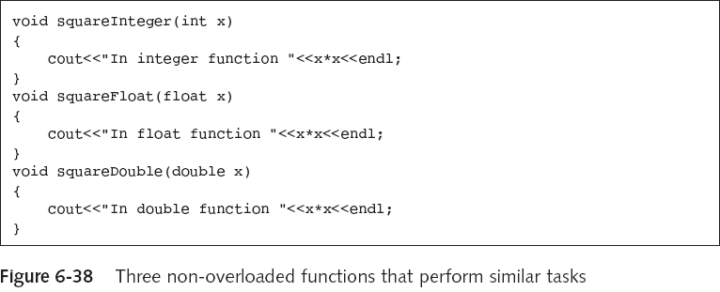
Overloading Functions
These three functions serve the same purpose but for different data types.

Slide 8
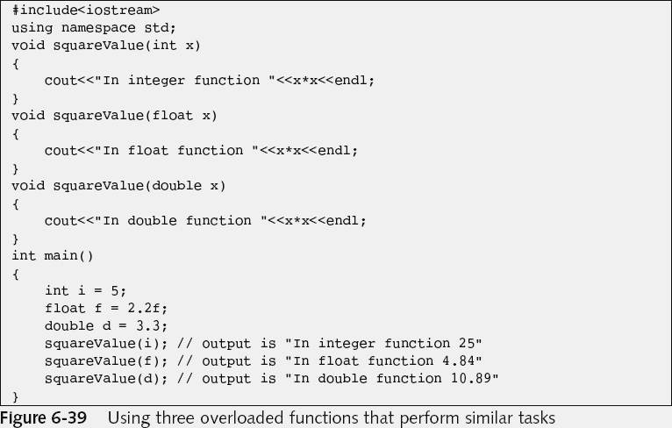
These three functions have a common purpose and also a common name.

Slide 9
Avoiding Ambiguity
Ambiguity occurs when the compiler cannot tell which version of a function to use. ☹
This can occur when you provide default values for the arguments to functions.
For example, consider the following declarations:
    void calculation(int a = 1);
    void calculation(char c = ‘A’);
Ambiguity arises if you call calculation() (i.e. without arguments).

Slide 10
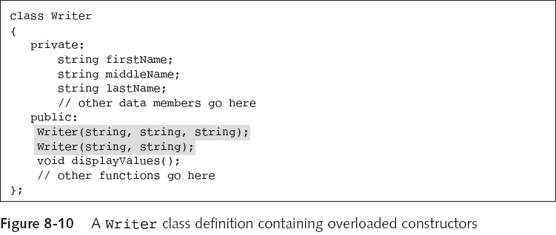
Overloading Constructors
These constructor functions have different signatures, different numbers and/or types of arguments.

Slide 11
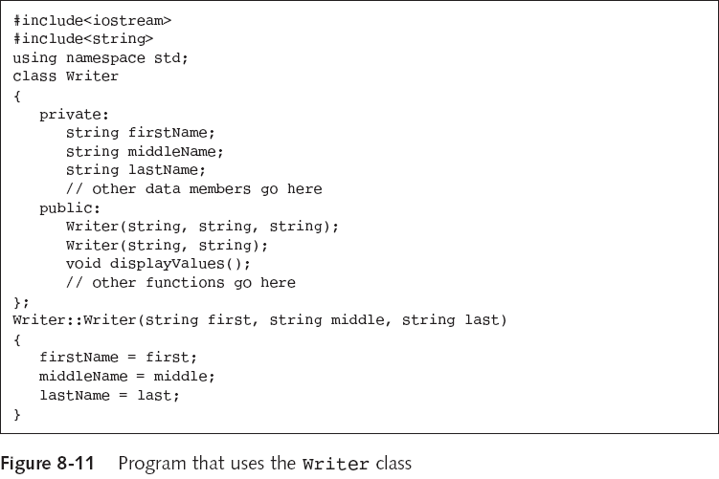

Slide 12
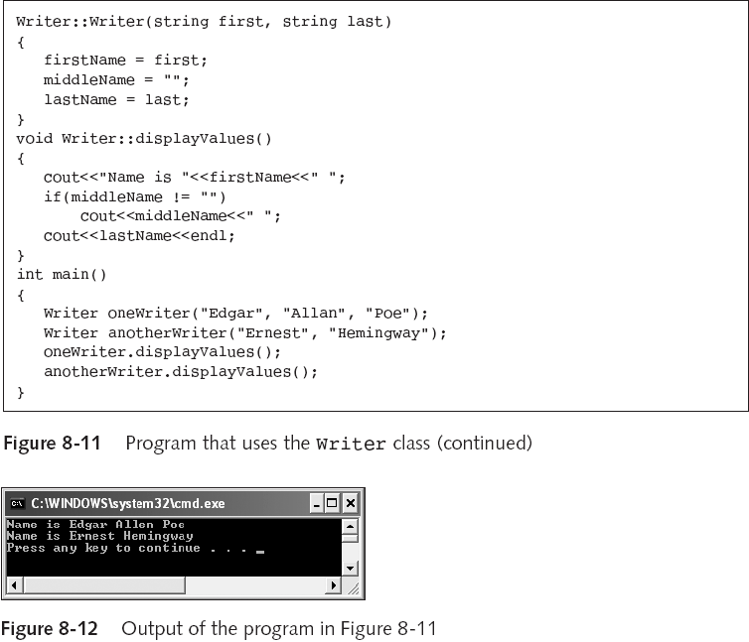

Slide 13
A warning on overloading…
You cannot overload by simply changing the return type of a function.
int calc(int a, int b)
{
int c=a*b;
return c;
}
float calc(int a, int b)
{
float c=a*b;
return c;
}
int main(){}
This won’t compile due to the ambiguity.
... line 6: Error: calc(int, int),
returning float, was previously declared returning int.

Slide 14
What are Friends?
Only class functions can access the class’s private data.
Sometimes you want to allow a nonmember function to access a private data member.
A friend function is a nonmember function that can access non-public class members.
  They should be used only when absolutely necessary.
  They shouldn’t be used simply to overcome encapsulation, which is one of the primary OOD principles.
A friend class is a class in which every function can access non-public members of another class.

Slide 15
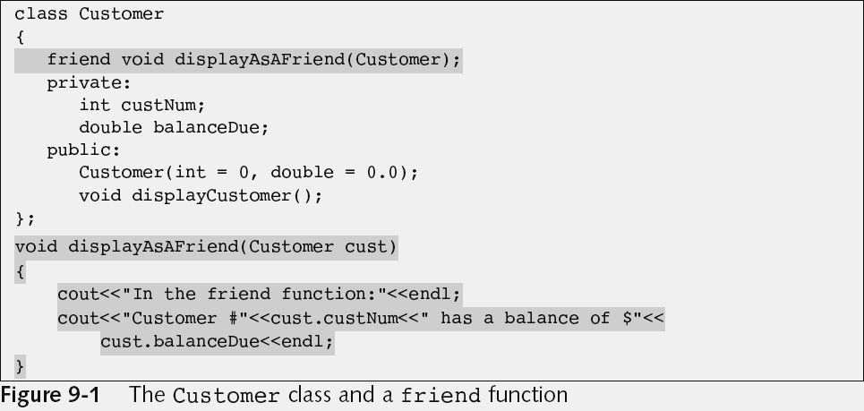
Declaring a Friend Function
We declare a particular function as a friend of the Customer class.

Slide 16
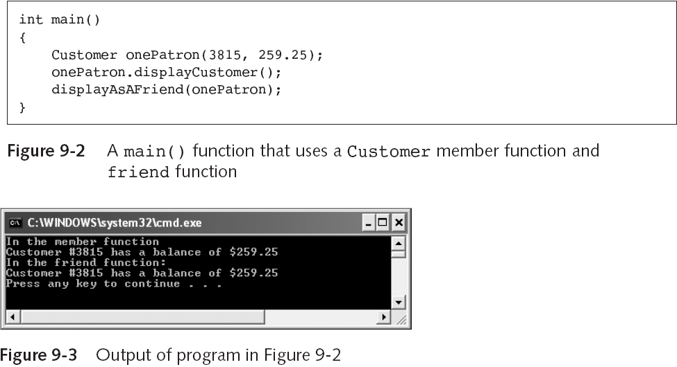
The displayAsAFriend function is able to access the private data of the Customer!

Slide 17
void Customer::displayCustomer()
{
cout<<"In the member function"<<endl;
cout<<"Customer #"<<custNum<<" has a balance of $"
<<balanceDue<<endl;
}
void displayAsAFriend(Customer cust)
{
cout<<"In the friend function:"<<endl;
cout<<"Customer #"<<cust.custNum<<" has a balance of $"<<cust.balanceDue<<endl;
}
The class version
The friend version

Slide 18
A nonmember function can be declared in the public or private section, or first in the class.
  Friend functions cannot be declared independent of a class.
  “Friendship” is a trust relationship bestowed by the class, a function cannot simply say it is the friend of another class.
The declaration of the function in the class must contain the keyword friend, but the implementation doesn’t need to.
  While the friend function is declared within the class it isn’t a member of the class!

Slide 19
You are not required to use the word friend within the function name of a friend function.
  It might be useful for documentation purposes or readability though.
Overloaded functions can be friends, but each must be explicitly designated as a friend function.
  They are necessary when you overload input and output operators for a class. We will look at this more later.
Some styles suggest listing the friend functions first in a class declaration.

Slide 20
Classes can be friends too!
We can have something like…
class A
{
friend class B;
int a;
};
class B
{
f(A &p){p.a=1;}
};

Slide 21
Friendship is not transitive
class A
{
friend class B;
int a;
};
class B
{
friend class C;
};
class C
{
void f(A &p){ p.a = 1;}
};
This WON’T work because C is not a friend of A.

Slide 22
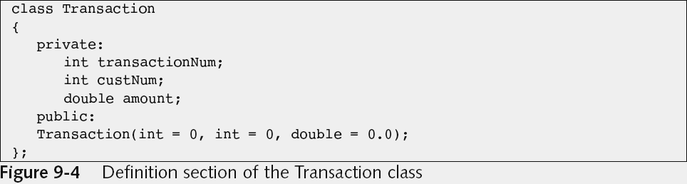
Accessing Data from Two Classes
Let us (partially) define a new class, to go along with the Customer class we had a few slides back.

Slide 23
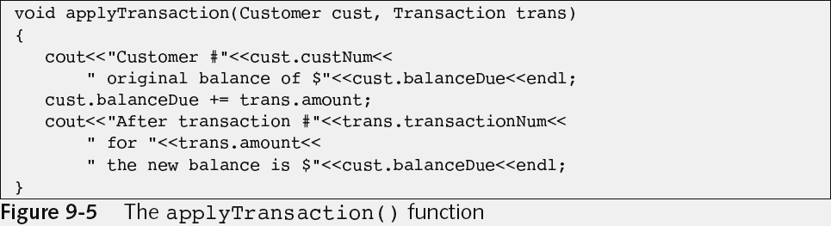
We can define a function which takes an object from the Customer class and an object from the Transaction class.
If it were declared as a friend within each class it could perform the function by accessing private data from both classes.
Remember the actual implementation of a function is outside of any class, even though it’s declaration as a friend is inside the class (or classes) it is a friend of.

Slide 24
Using a Forward Reference
Consider that we try to declare the applyTransaction function in the Customer class:
  How does the compiler know about the Transaction class if the Customer class is listed first?
  Similarly, vice versa if they are defined the other way around.
A forward reference is a statement that lets the compiler know that the class exists, and that the details will come later.

Slide 25
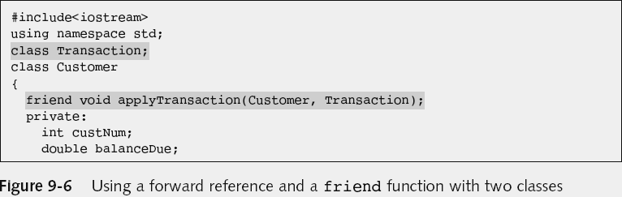
A forward reference is a bit like a prototype for a class or for a function.

Slide 26
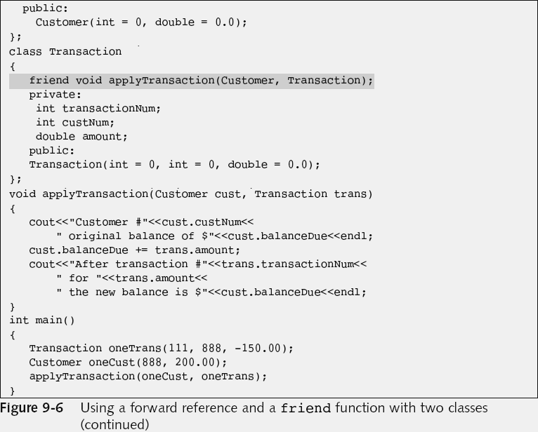
…
…

Slide 27
More on forward references
When two classes refer to each other, you can choose to forward declare either one, and then define the other class first.
If two or more classes share a friend function that makes a reference to all the classes:
  Forward declare all the classes except one.
  Define the class you did not forward declare, and include the friend function prototype in the class definition.
  Define all classes that you did forward declare, including the friend function prototypes in the class definitions.
  Define the friend function itself.

Slide 28
Overloading Operators–The Rules
We are now ready to return to operator overloading.
Operator overloading allows you to apply operators to your own abstract data types (i.e. objects).
You can overload the + operator to have any meaning, but good programming style dictates that you give a reasonable meaning:
  You can overload + to “add” two Students.
  You also can overload + to work with diverse types.

Slide 29
You overload an operator by making it a function.
There are some properties of the operator which you cannot change:
  If an operator is normally defined to be unary only, then you cannot overload it to be binary.
  Note that some operators are already overloaded with unary and binary versions (+ for example).
  You can’t change associativity or precedence either.
  Those factors are governed outside of the function definition.

Slide 30
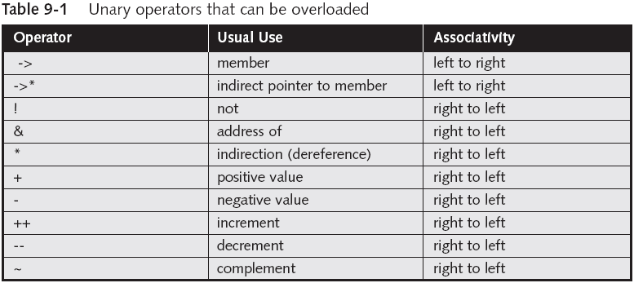
Associativity: This is an unfortunate term and in this context refers to the order in which actions within an expression are carried out.
It means whether the operator acts to the left or right first, or takes input from the left or right first.
  It is not the same as associativity in the sense of ordinary addition being associative ⬅➔ (a+b)+c=a+(b+c).

Slide 31
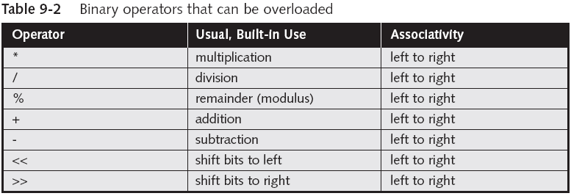
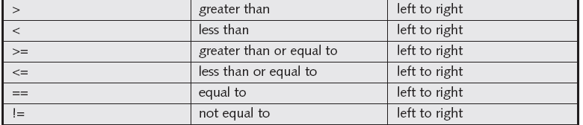

Slide 32
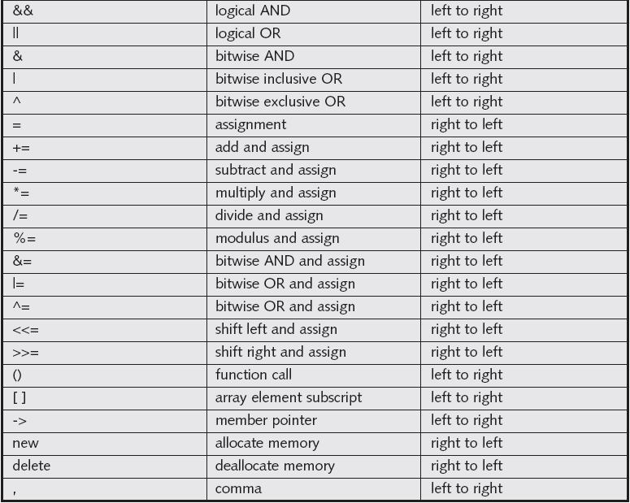

Slide 33
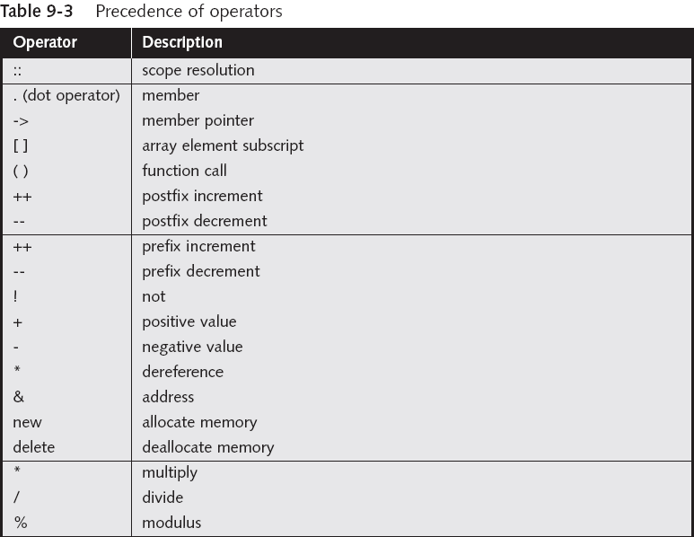

Slide 34
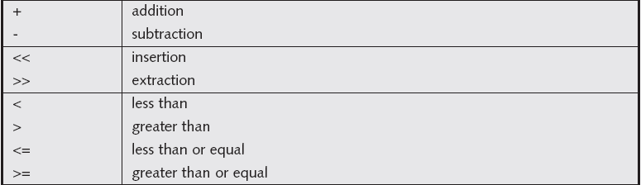
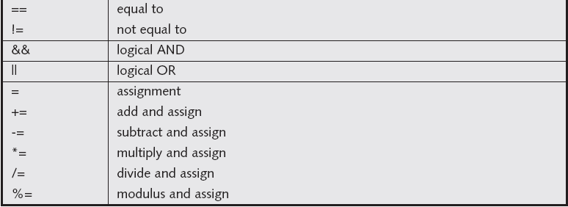

Slide 35
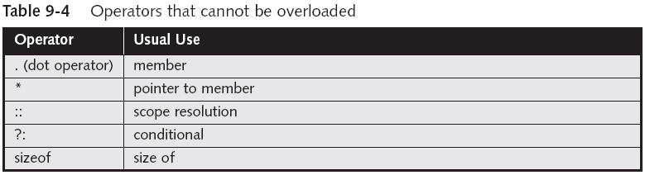
Some operators cannot be overloaded:
  There are five such operators.
You cannot overload operators using symbols that are not operators in C++ already (such as $).
Operators cannot be overloaded for built-in types.
  You might like to swap the definitions of addition and subtraction for int but cannot. ☹

Slide 36
Considering the following example
Class Time describes a time of day:
  Between 00:00:00 and 23:59:59
  Calculate the second elapsed from 9:00am until now:
    Time now, morning(9,0,0);
    int seconds_elapsed = now – morning;
  We have to change/define the meaning of “-” for the Time objects:
    operator overloading

Slide 37
Two ways to overload an operator
As a non-member function or friend function.
Overloading Operator Definition
return_type operatoroperator_symbol( parameters )
{
statements
}
Example: | int operator-( Time a, Time b ) { return a.seconds_from( b ); }
Purpose: | Supply the implementation of an overloaded operator.

Slide 38
As a member function.
Overloading Operator Member Function Definition
return_type ClassName::operatoroperator_symbol( parameters )
{
statements
}
Example: | Time Time::operator+( int sec ) { Time r = *this; r.add_seconds(sec) return r }
Purpose: | Supply the implementation of an overloaded operator member function.

Slide 39
Which way should we choose ?
Some operators (e.g., assignment) are required to be members.
Usually the programmer has the choice.
Keep in mind:
  Non-members have only public access, unless they are friends.
  No implicit conversion for implicit parameters.
Member function is preferable if:
  The left argument is modified (+=).
  The data fields are not easily accessible.

Slide 40
Ways of using the operators
For example for the class Time:
  Time a, b, c;
  Different uses of the operator + :
    a = a + 10;
    a = 10 + a;
    a = a + b;
    a= a + b + c;
    int seconds = a + b;
    int seconds = a + 10;
    int seconds = 10 + a;
  The allowed ways of using the operator decides how the operator should be overloaded (e.g. return types & parameters).

Slide 41
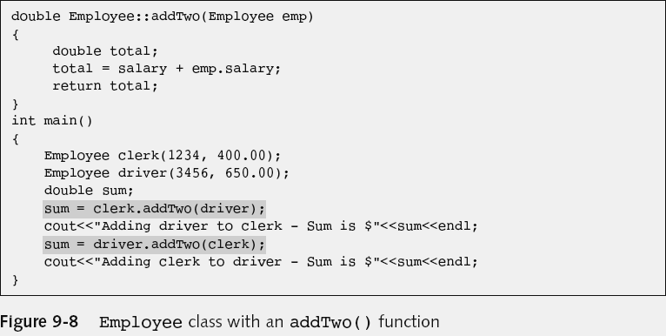
Overloading an Arithmetic Operator
Without overloading, you (might) have to use awkward functions.
This is unnatural

Slide 42
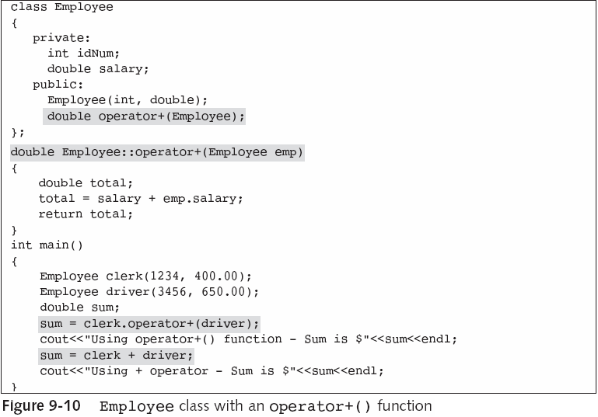
Declaration
Implementation
Preferable notation

Slide 43
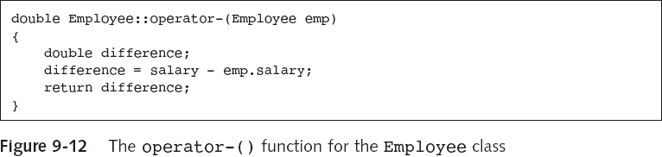
The Order of the Operands
We have to be careful when the order matters.
  For example, with subtraction.
  Subtraction is non-commutative.
This is different from
emp.salary - salary

Slide 44
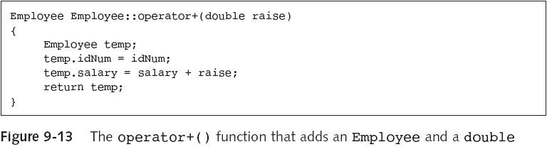
Overloading an Operator to Work with an Object and a Primitive Type
Now you can write a statement such as
  aClerk = aClerk + 50.00; ☺
But not:
  aClerk = 50.00 + aClerk; ☹
  The next slide shows a solution to this…

Slide 45
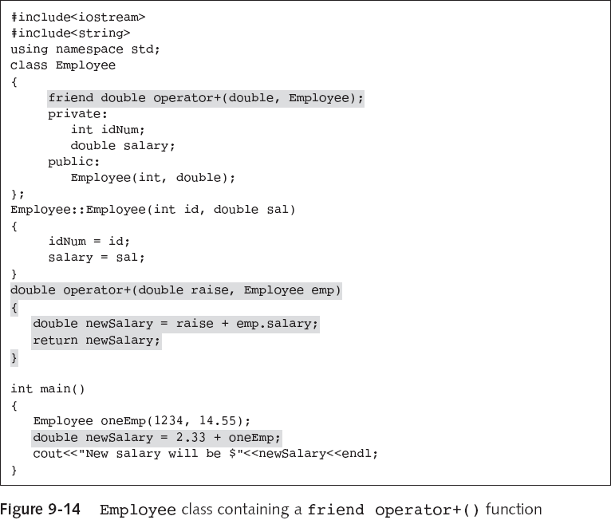
The + operator can now deal with a double and an
Employee.

Slide 46
Multiple Operations in a Statement
Most languages allow you to chain operations, that is, they allow several operators within the same statement.
When you write a statement using integers or doubles, such as total = a + b + c;, first a and b are added, creating a temporary value; then, c is added to the temporary value, and the final result is stored in total.
The same rules of operation apply when you want to create class objects that can use multiple operations in a statement.

Slide 47
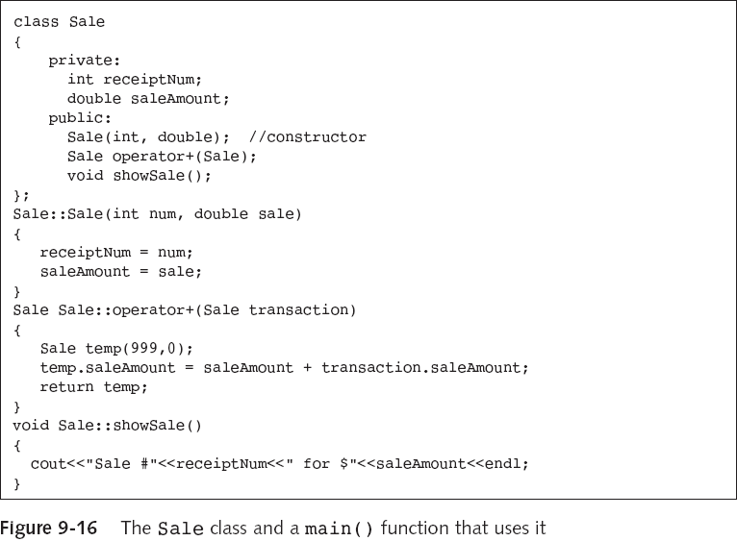
Some definitions
to begin with.

Slide 48
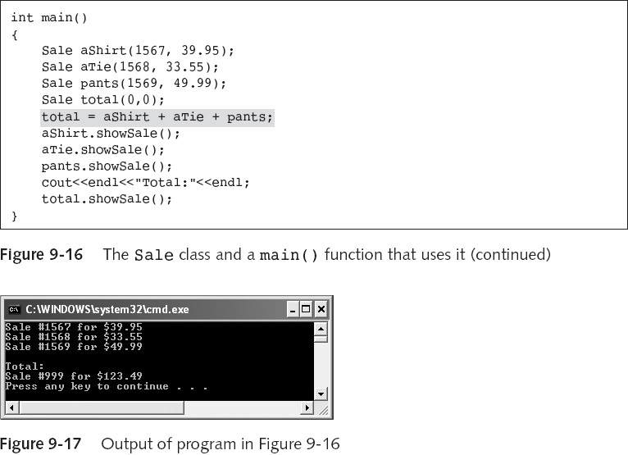
We are setting up
three different Sale
objects and adding
them to get the total
cost.

Slide 49
A word of caution
If we are chaining operations we need to be sure that intermediate operations make sense.
  In general, this can be satisfied if the addition of two objects of the same type returns a third object of that same type.

Slide 50
Overloading Output
In C++, << is both a bitwise left-shift operator and an output operator (insertion operator).
The << operator acts as an output operator when cout (or another output stream object) appears on the left side.
cout becomes the driving object and “the this” object in the overloaded operator<<() function
  ostream& operator<<(ostream &, int);
  Stacking: refers to the use of multiple calls to the same operator function (for example, cout<<22<<33;).

Slide 51
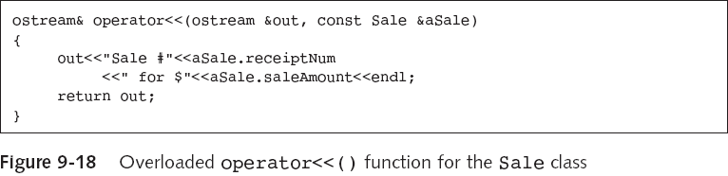
To overload the << operator so it can work with a Sale object, you must add the overloaded operator<<() function to the Sale class as a friend!
friend ostream& operator<<(ostream &,const Sale &);
Why as a friend?
Note that the function name is not Sale::operator<<()

Slide 52
Why make << and >> friends?
They need to be able to access private members of the iostream classes, in particular cin of istream and cout of ostream.
The operators << and >> are overloaded (templated) functions which are friends of the iostream class already.
When an overloaded operator is a class member, the class member is only invoked when the operator is used with a left operand that is an object of class type.
If the operator must be used with a left operand of another type, then the overloaded operator must be a non-member. e.g., stream extraction (<<) and insertion (>>) must be non-members.

Slide 53
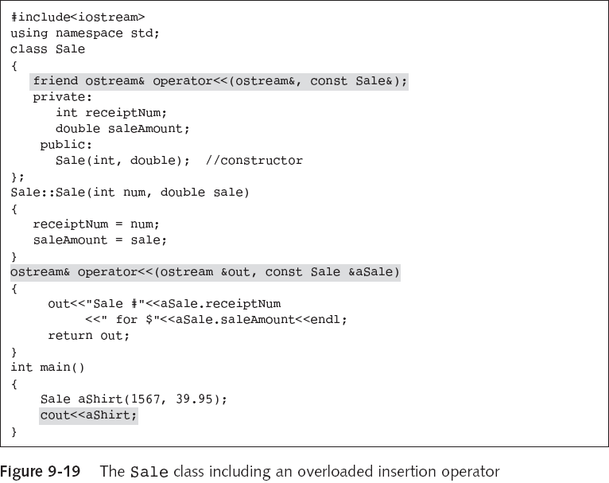

Slide 54
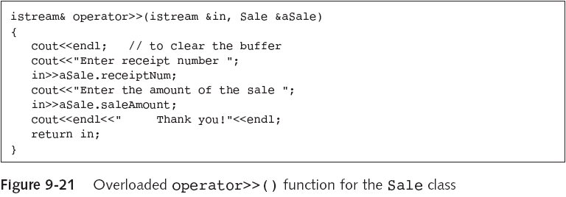
Overloading Input
Here we overload the extraction operator.
Note again that this function is for objects of a particular class but isn’t a class member. The signature (prototype) identifies the associated class.

Slide 55
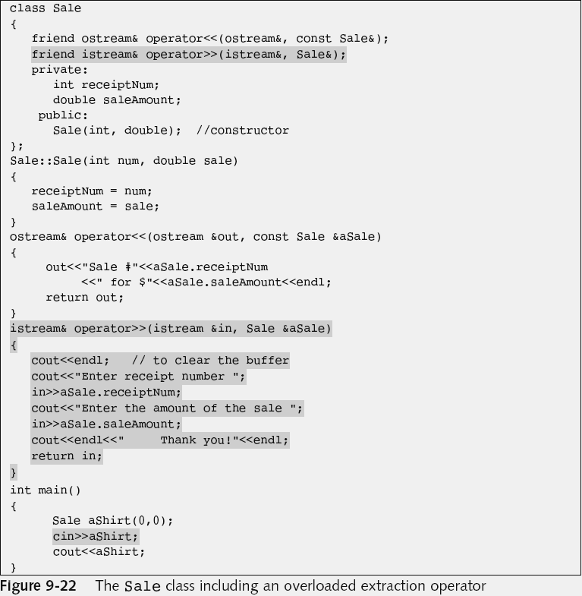

Slide 56
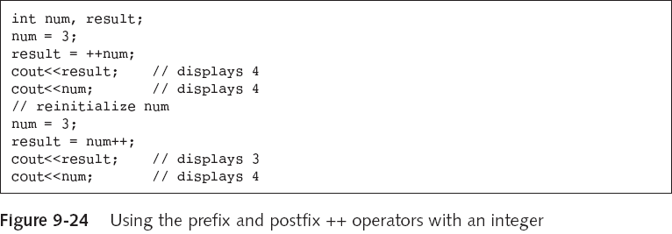
Overloading the Prefix ++ and --
We can overload other operators too.
We are going to use an example to illustrate the overloading of ++, since it has an extra twist.

Slide 57
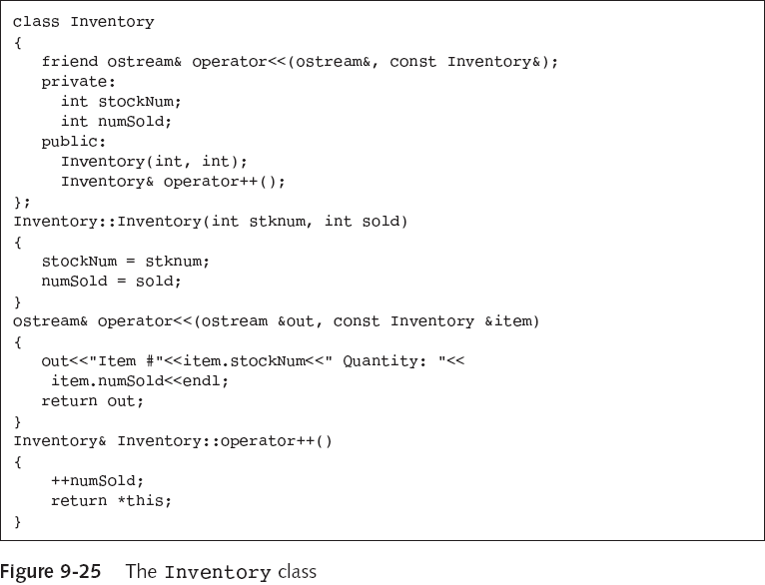

Slide 58
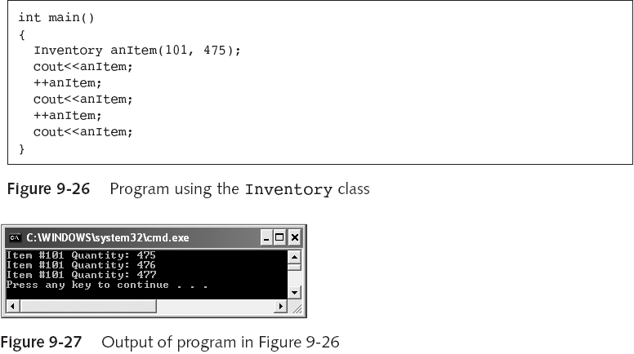
We have only used the prefix form.
The postfix form isn’t going to work here. ☹

Slide 59
Using Postfix Increment and Decrement
The Inventory class postfix operator++() function prototype is:
  Inventory& operator++(int);
The int argument to the Inventory class operator++() function is a dummy argument!
  This argument isn’t the function but provides a different function prototype.
A function’s prototype is also called its signature.
  The prefix and postfix increment operator functions have different signatures.

Slide 60
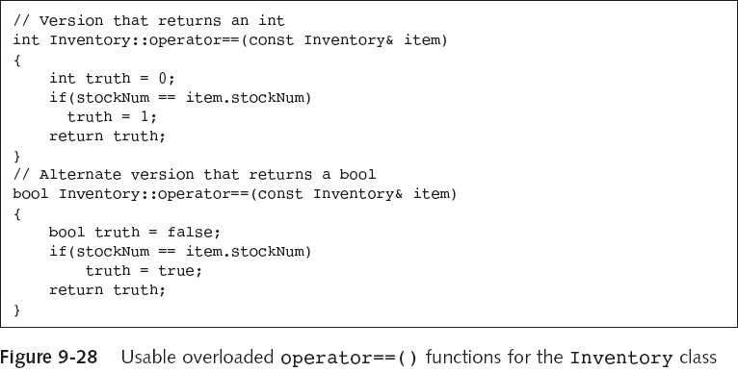
Overloading the == Operator
Equality can be taken to mean different things for different objects. Notice again that the signatures differ between the two overloads.

Slide 61
Overloading the = Operator
If you want the = operator to do something other than assign each member, then you must create a custom operator=() function.
If a class contains a pointer and you create two objects from the class and assign one object to the other, then the two objects will contain pointers to the same memory. This is fine but …
  If one of the objects is deleted or goes out of scope, the memory to which that object points is released.
  Now the second object contains a pointer to deallocated memory, memory that is no longer assigned to anything in the application. This is not so great. ☹

Slide 62
When you declare any data field, you allocate memory for that field—that is, you allot storage for it and assign a name to the location.
Most memory allocation is accomplished when you compile a program.
When you allocate memory later, during the execution of a program you dynamically allocate memory.
new operator: dynamically allocates memory.
delete operator: frees previously allocated memory.
  Using delete in the destructor is a good idea since the destructor is always called when an object goes out of scope.

Slide 63
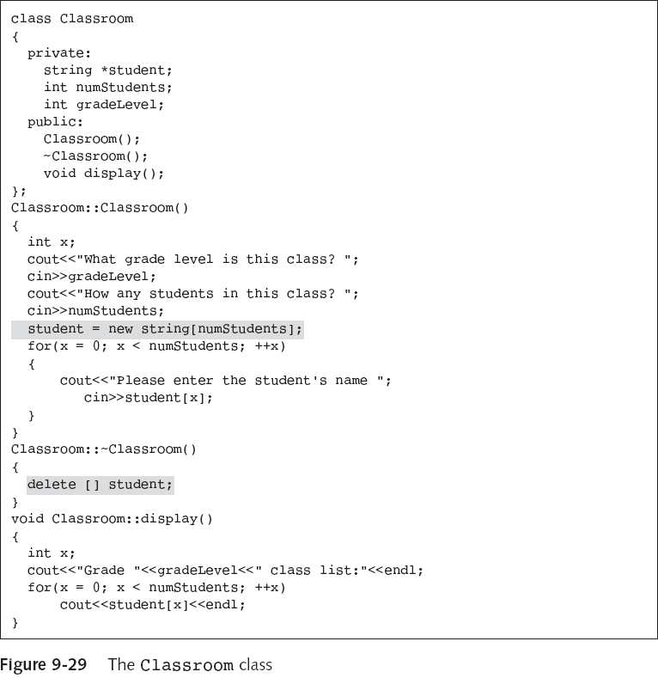
Here we
allocate
and
release
memory.

Slide 64
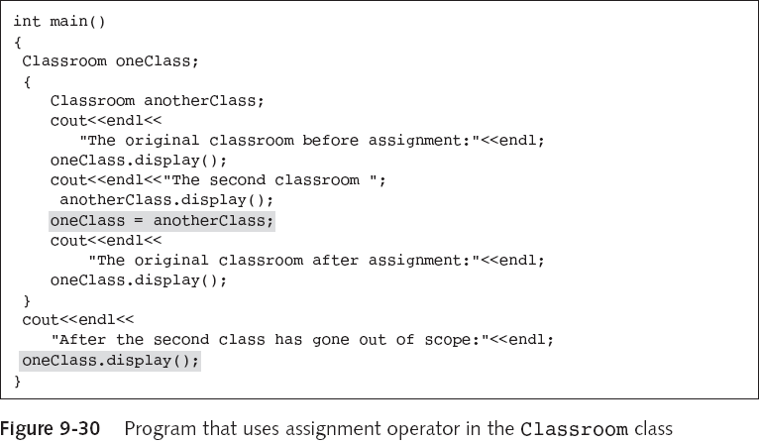
More on overloading =
First we use the default = operator.

Slide 65
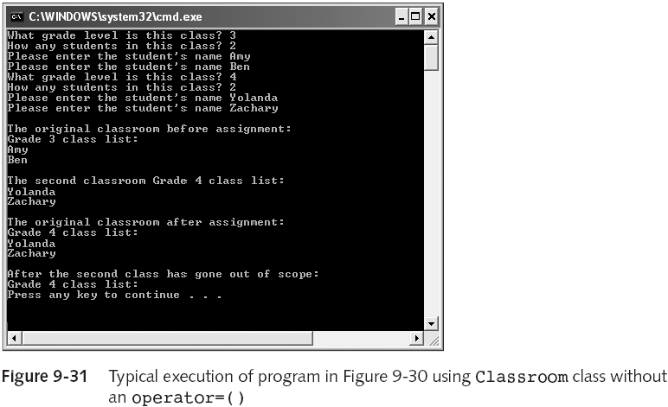
We have lost the information we copied after anotherClass went out of scope. ☹

Slide 66
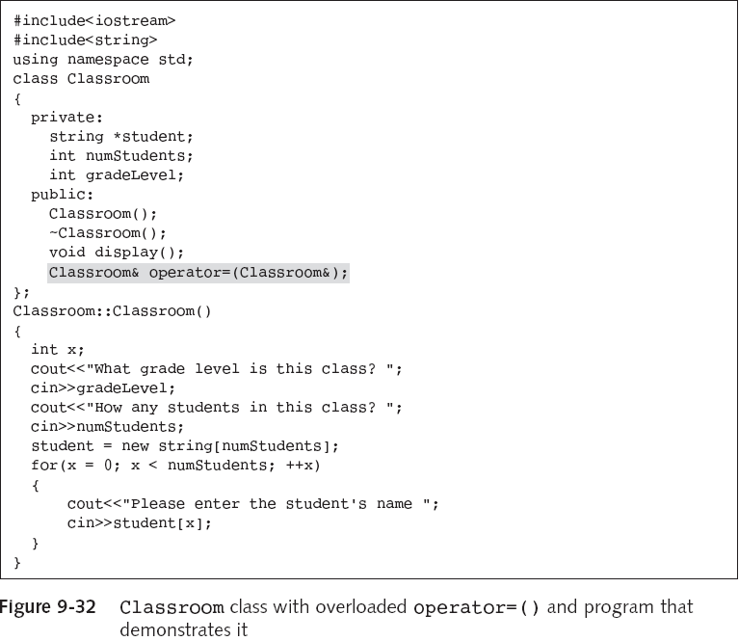
Now we use an overloaded = operator.

Slide 67
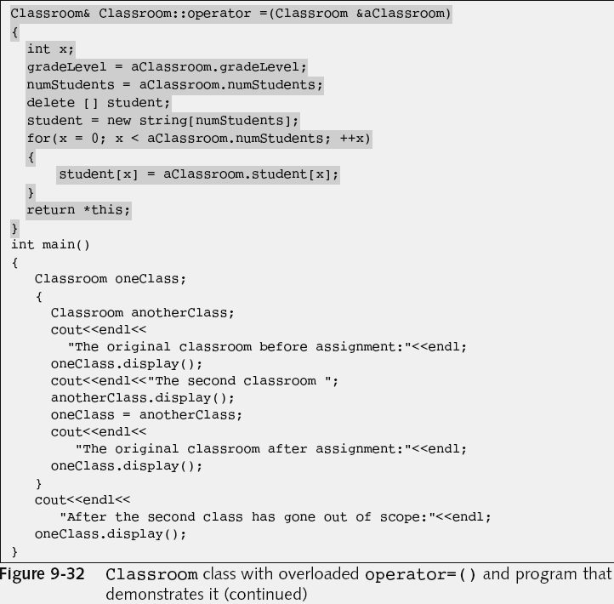
Here we deallocate the memory associated with the old object first, then allocate new memory. The old and new pointers point to different places!

Slide 68
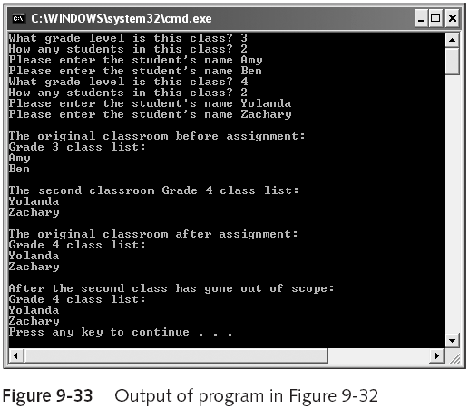
We haven’t lost the information now!

Slide 69
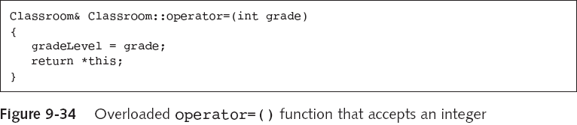
Overloading []
The subscript operator, operator[], is declared like any other function, but called as if accessing an array element.
  The argument is not required to be an integer.
You can use the parentheses operator, operator() to specify a different signature and function associated with an already used operator.
  We used this earlier with ++ to distinguish postfix and prefix operations.

Slide 70
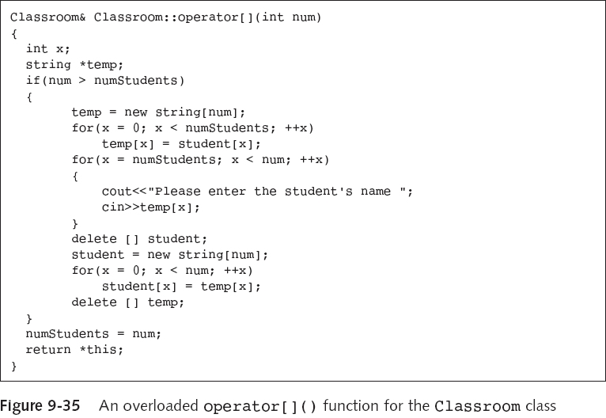
We can add in more students now, after copying the old into new memory and releasing the old to avoid problems.

Slide 71
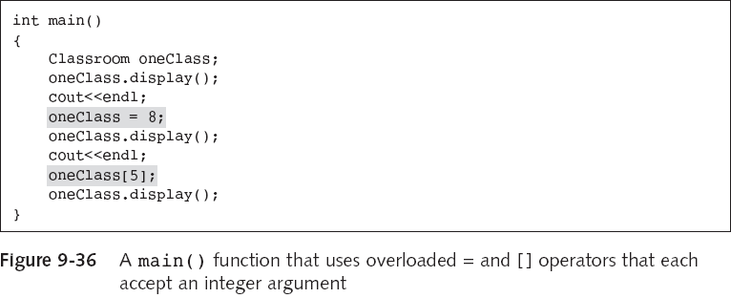
The = operator allows us to change the grade of the class.
The [] operator is used to assign as many additional students we need to fill up the class.

Slide 72
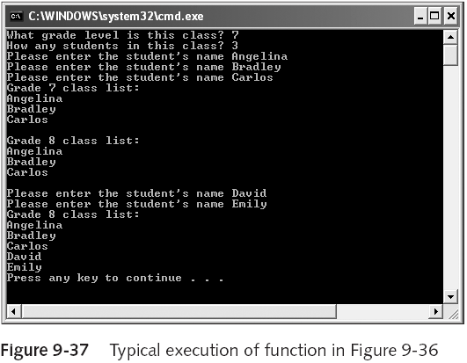

Slide 73
Overloading new[]
Sometimes we want to makes an array objects using new[], but without the default behaviour.
Here goes part of the declaration for a class with a couple of overloaded new[] operators.
class Thing
{
private:
int value;
public:
void* operator new[](size_t size);
void* operator new[](size_t index, size_t extra);
};

Slide 74
An example ()
void *Thing::operator new[](size_t size, size_t extra)
{
size_t n = size / sizeof(Thing);
Thing *op = ::new Thing[n];
for (size_t idx = 0; idx < n; idx++)
op[idx].value = extra+idx; // Sets values.
return op;
}
We could use the statement
Thing *op = new(10) Thing[5];
to construct five Thing’s with values 10, 11, 12, 13, 14.

Slide 75
#include<iostream>
#include<cstring>
using namespace std;
class Thing
{
private:
int value;
public:
void* operator new[](size_t index, size_t extra);
void show(){cout << "Value is " << value << endl;}
};
void *Thing::operator new[](size_t size, size_t extra)
{
size_t n = size / sizeof(Thing);
Thing *op = ::new Thing[n];
for (size_t idx = 0; idx < n; idx++)
op[idx].value = extra+idx;
return op;
}
int main()
{
Thing *op = new(10) Thing[5];
for (int i=0; i<5; i++)
op[i].show();
}

Slide 76
Case Study: Fractional Numbers
See the code:
  fraction.cpp
  Lots of overloaded operators:
<<, >>, +=, ++ (pre,post), +, - (unary,binary), *, /, <, <=, ==, !=, >=, >.
New type to represent a ratio of 2 integers:
    Fraction a( 3, 4 ); // Represents ¾
    Fraction b( 7 ); // Represents 7/1
Fractions should behave as real numbers in terms of addition, subtraction, multiplication and division.

Slide 77
Summary
A friend function:
  can access non-public members of a class, even though it is not a class member.
  doesn’t use the class name and the scope resolution operator in the function header.
Polymorphism allows the same operation to be carried out differently, depending on the object.
If you make a function a friend of multiple classes, it can use data from each class.
Operator overloading allows you to apply operators to your own abstract data types.

Slide 78
The name of the operator function that overloads the + symbol is operator+().
When you create an overloaded operator, the objects on both sides can be different types.
Most languages allow you to “chain operations”.
The << operator is overloaded by C++; it is called the insertion operator when used for output.
The extraction operator (>>) operator can also be overloaded for input.

Slide 79
If you want to use a postfix ++ operator with a class, you need a dummy integer argument.
To overload operator==(), you must decide what constitutes equality in class members.
Unlike the other operators, if you don’t define the = operator, C++ defines it for you.
C++ provides two special operators, the subscript operator and the parentheses operator, that can be used as adjuncts to more conventional operators.
An overloaded new[] operator can be used to construct arrays of objects constructed with non-default values.

